Slide 1
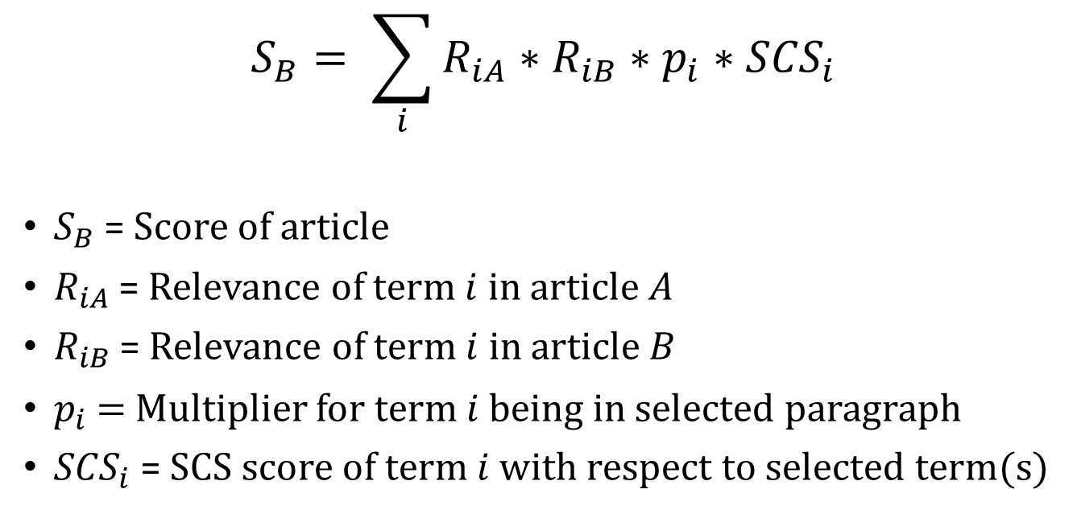
Ranking Articles
$$S_{B}= \sum_{i}{R_{iA}∗R_{iB}∗p_{i}∗{SCS}_{i}}$$
$S_{B}$ = Score of article
$R_{iA}$ = Relevance of term $i$ in article $A$
$R_{iB}$ = Relevance of term $i$ in article $B$
$p_{i}$ = Multiplier for term $i$ being in selected paragraph
${SCS}_{i}$ = SCS score of term $i$ with respect to selected term(s)
Returns one score

Slide 2

Entity extraction
Relevance
Linked Data (Dbpedia, Yago, etc.)

Slide 3
Relevance
0,35
Petrobras creditors could request an acceleration of payments on some of its debt if the company doesn’t release an audited financial statement by the end of May.
Public prosecutors are investigating 20 companies, including 16 builders, for participating in a alleged cartel to overcharge the oil company. OAS and Galvao Engenharia SA, Brazilian construction companies, filed for bankruptcy after investigations started.
The president said the builders financial difficulties won’t hold up planned tenders to build and operate infrastructure projects. She said she plans tap Chinese investment for a railway linking Brazil’s Atlantic coast with the Pacific Ocean.
The Supreme Court has also authorized investigations of 49 politicians including Senate chief Renan Calheiros and lower house President Eduardo Cunha in relation to the alleged kickbacks at Petrobras. Former officials at the company turned state’s witness said that hundreds of millions of dollars went to political parties, including Rousseff Workers’ Party. The scandal has eroded the support she needs in Congress to approve austerity measures.
0,63
0,11
0,88
0,78
0,63

Slide 4
SCS Connector
Petrobras creditors could request an acceleration of payments on some of its debt if the company doesn’t release an audited financial statement by the end of May.
Public prosecutors are investigating 20 companies, including 16 builders, for participating in a alleged cartel to overcharge the oil company. OAS and Galvao Engenharia SA, Brazilian construction companies, filed for bankruptcy after investigations started.
The president said the builders financial difficulties won’t hold up planned tenders to build and operate infrastructure projects. She said she plans tap Chinese investment for a railway linking Brazil’s Atlantic coast with the Pacific Ocean.
The Supreme Court has also authorized investigations of 49 politicians including Senate chief Renan Calheiros and lower house President Eduardo Cunha in relation to the alleged kickbacks at Petrobras. Former officials at the company turned state’s witness said that hundreds of millions of dollars went to political parties, including Rousseff Workers’ Party. The scandal has eroded the support she needs in Congress to approve austerity measures.
0,23
0,56
0,76
0
0,83

Slide 5
Ranking Articles
$$S_{B}= \sum_{i}{R_{iA}∗R_{iB}∗p_{i}∗{SCS}_{i}}$$
$S_{B}$ = Score of article
$R_{iA}$ = Relevance of term $i$ in article $A$
$R_{iB}$ = Relevance of term $i$ in article $B$
$p_{i}$ = Multiplier for term $i$ being in selected paragraph
${SCS}_{i}$ = SCS score of term $i$ with respect to selected term(s)
Returns one score

Slide 6
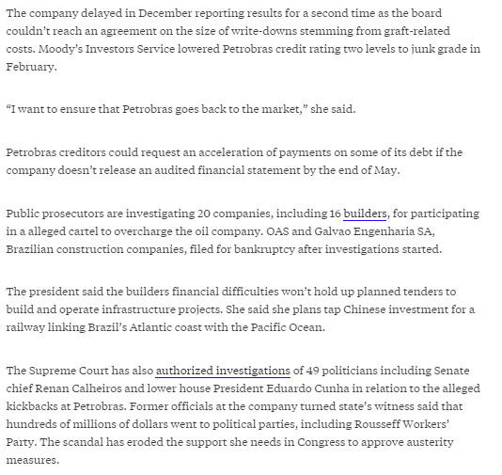
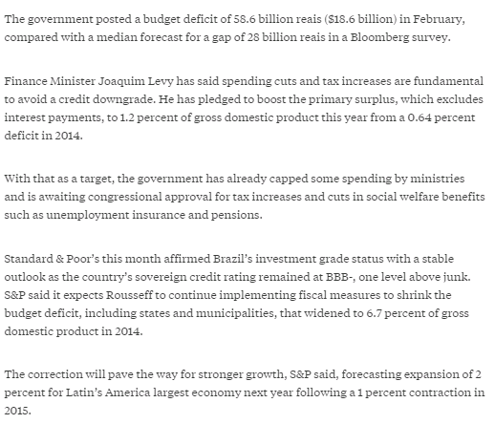
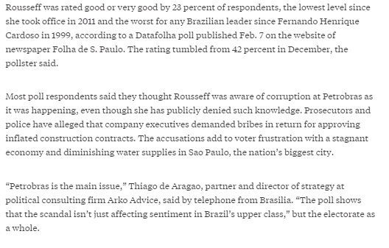
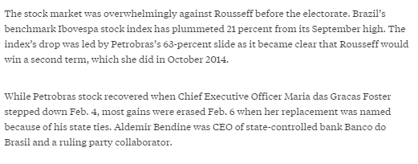
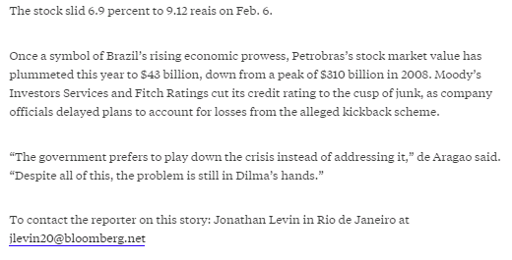
Adding Diversity
Maximal Marginal Relevance
Max Relevance vs Min Relevance
Original document
Other results

